Slide 1
Staining

Slide 2
Since living bacteria are generally colorless, transparent and almost invisible, staining is necessary in order to make them readily visible for observation of intracellular structures as well as overall morphology

Slide 3
Stains= colored organic compounds used for staining microorganisms.
Chemically
Stains=Benzene ring+ chromophore+ Auxochromes
Benzene ring (colourless solvent)
Chromophore (chemical group that imparts colour to benzene)
Auxochrome (chemical group that conveys property of ionisation to chromogen enabling it to bind to the tissue)

Slide 4
Types of stains
Acidic dyes: has negative charge so they bind to positively charged cell wall structures like some proteins.
- Not very oftenly used.
Used for capsule staining
Ex: Nigrosine,Picric acid, Eosin, Acid fuschin, India ink
Basic dyes: has positive charge so they bind to negatively charged molecules like nucleic acids,-COOH,-OH.
Since bacterial cell surface are also negatively charged, basic dyes are most commonly used.
Ex: Crystal violet, Methylene blue, Safranin, Basic fuschin.
Neutral dye: complex salt of a dye acid with a dye base Ex: Eosinate of Methylene blue, Giemsa stain

Slide 5
Staining:-
Process of coloration of bacteria by use of stains/dyes.
Types:-
1)Simple staining and
2)differential staining
Differential is further two types
Visualisation of structure- spore stain, capsule stain, nuclear
Separation of group-gram stain, AFB stain

Slide 6
Gram staining
The Gram stain (named after Hans Christian Gram: 1853–1938) is the most useful and widely employed differential stain in bacteriology. It divides bacteria into two groups; gram negative and gram positive.
The first step in the procedure involves staining with the basic dye crystal violet. It is followed by treatment with an iodine solution. The smear is then decolorized by washing with an agent such as 95% ethanol or isopropanol-acetone. Finally, the smear is counterstained with a basic dye, safranin. Gram staining is usually the beginning point in identification procedure for bacteria.

Slide 7
Principle
When crystal violet and iodine is used, the bacteria picks up the colour and appears purple.
Iodine enhaces the staining reaction between the dye (crystal violet) and the internal cellular contents of bacteria.
The alcohol (acetone) treatement decolorizes Gram negative bacteria while Gram positive bacteria retain the purple colour.
When counterstain safranin is used, gram negative bacteria becomes red.
Therefore under oil immersion microscopic examination, gram negative bacteria appears red whereas gram positive appear purple in colour

Slide 8
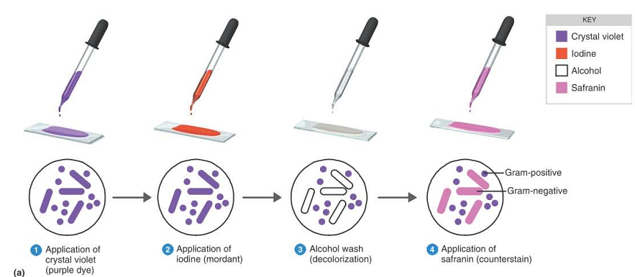

Slide 9
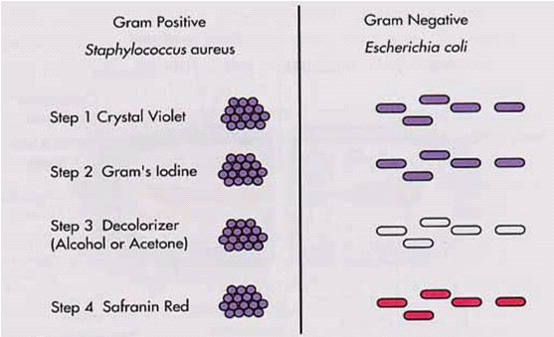

Slide 10
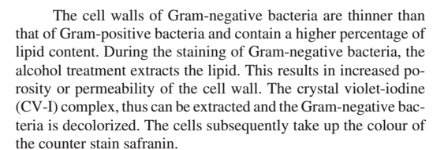
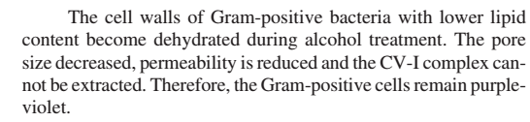

Slide 11
Material Required
Samples:all types of specimen and culture
Crytal violet( primary stain)
Gram’s iodine(modrant)
decolorizer(alcohol-acetone or 95% ethanol)
Safranin( counter stain)

Slide 12
Procedure
Take a clean grease free slide
Transfer a loopful of culture (specimen) by a sterilized inoculating loop and make a thin smear on the centre of the slide in an oval manner.
allow the smear to dry in the air.
fix the dry smear by passing the slides 3-4 times through the flame quickly with the smear side facing up.

Slide 13
Flood the smears with crystal violet and let stand for 60 seconds.
Rinse with water
Cover with Gram’s iodine and let stand for 30 minute
Decolorize with 95% ethanol for 15 to 30 seconds. (Do not decolorize too long.
Add the decolorizer drop by drop until the crystal violet washed off from the slide. Alternatively, the smears may be also decolorized for 30 to 60 seconds with a mixture of isopropanol-acetone (3:1 v/v).
Rinse with water
Counterstain with safranin for about 60 seconds
Rinse with water
Blot dry with bibulous paper/air dry and examine under oil immersion.

Slide 14
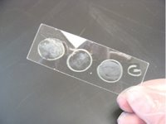

Slide 15
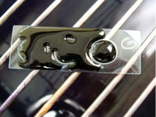
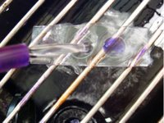

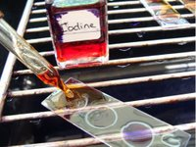
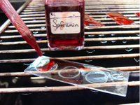



Slide 16
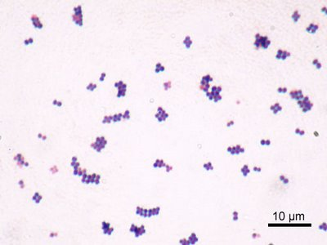
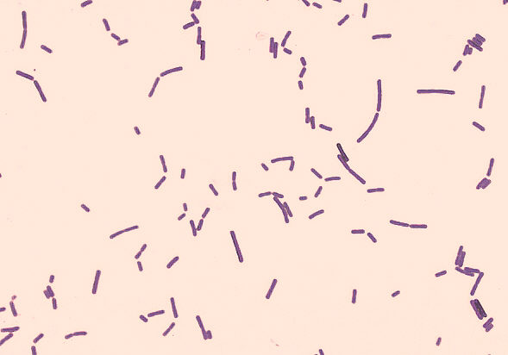
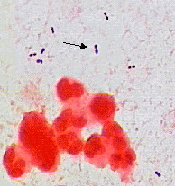
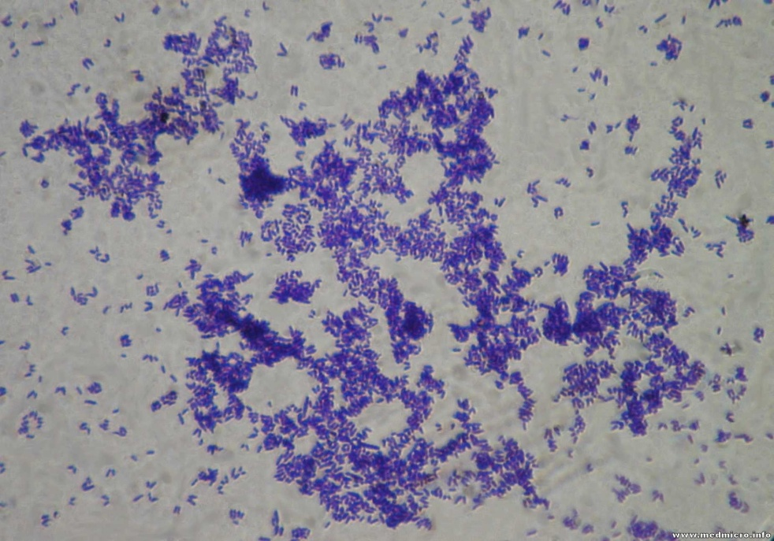
Gram positive cocci
Gram positive rods

Slide 17
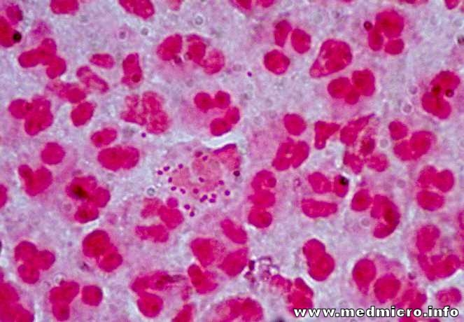
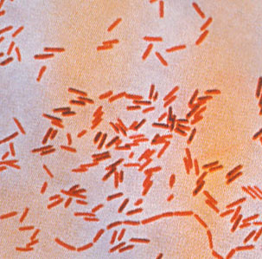
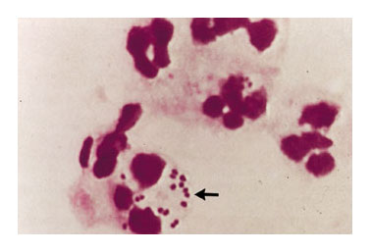
Gram negative rods
Gram negative cocci

Slide 18
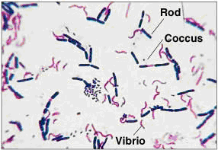
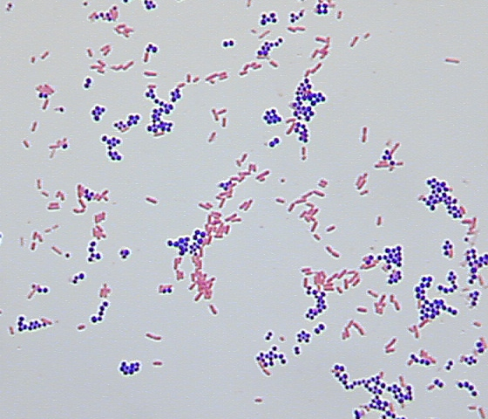
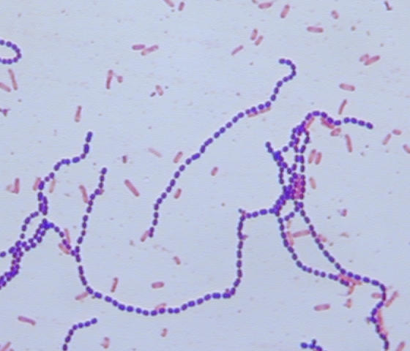
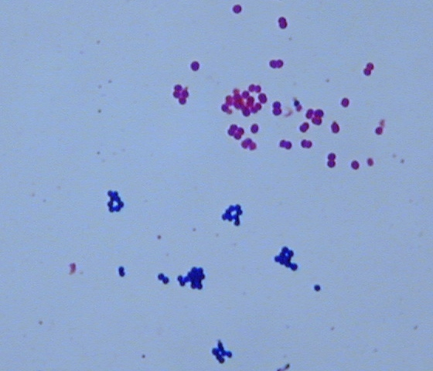
Mixed organisms

Slide 19
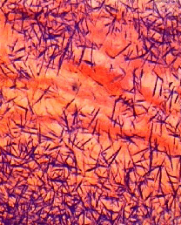
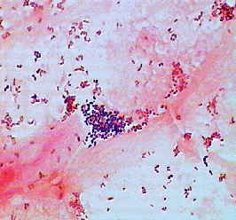
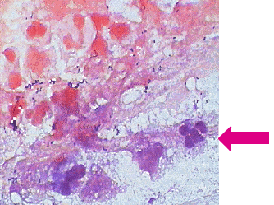
Improper Gram staining
Crystal violet precipitate crystal
Over-decolorization
Under-decolorization

Slide 20
Result and interpretation
Gram-positive organisms stain blue to purple
Gram-negative organisms stain pink to red.
Reporting Gram smears
The report should include the following informations:
Numbers of bacter present, whether many,moderate, few, or scanty.
Gram reaction of the bacteria, wether positive or Gram negative.
Morphology of the bacteria, whether cocci, diplococci, streptococci, rods or coccobacilli.Also , whether the organisms are intracellular.
Presence and number o pus cells

Slide 21
Acid Fast Staining (AFB) / Ziehl- Neelsen staining (ZN)
Acid fast staining is also a differential staining that differentiates bacteria into acid fast and non acid fast. It is also known as Ziehl-Neelsen technique. It is usually done for staining and identification of Acid fast bacteria like Mycobacterium tuberculosis

Slide 22
Principle
Acid fast bacteria like Mycobacterium tuberculosis are difficult to stain by ordinary methods because it contains lipid mycolic acid in its cell wall.
Such acid fast bacteria bind carbol fuschin tightly and resist destaining with strong decolorising stain (acid-alcohol). Non acid fast bacteria readily loose the stain when treated with acid-alcohol solution.
When counterstain Methylene blue (or Malachite green) is used, the decolorised non-acid fast bacteria and other cells take blue colour whereas acid fast bacteria appears red colour

Slide 23
Materials required
Sample:- sputum
Carbol fushin
Acid alcohol(3%HCI in 95% ethanol)
Methylene blue
Slides, microscope, inoculating loop

Slide 24
Procedure
Prepare smear from sputum specimen on a glass slide and fix it by heating.
Place the slide on a staining rack and flood with carbol fuschin stain.
Heat gently by bunsen burner flame from below untill the steam rises and leave for 5 minutes. (avoid boiling and donot allow the stain to dry, if necessary add more stain)
Wash with distilled water.
Cover the slide with decoloriser and rock the slide for about 15 seconds.(Untill the red colour is no longer coming off the slide)
Wash with distilled water.
Counter stain with Methylene blue for 1 minute.
Wash with distilled water.
Air dry or blot dry the stain and observe under microscope.

Slide 25
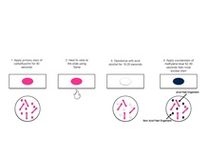

Slide 26
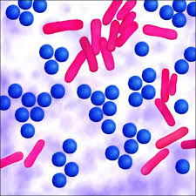

Slide 27
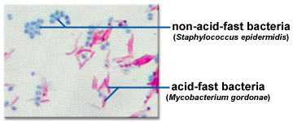

Slide 28
Interpretation
AFB appears red while the epithelial cells, pus cells and other bacteria are stained blue ( or green if malachite green is used). AFB is recognized by thin typical morphology. They are arranged in twisted bundles or slightly curved.
smears should be examined carefully for 15 mins and at least 100 visual fields should be scanned for negative determination.

Slide 29
Reporting
When any definite red bacilli are seen, report the smear as “AFB Positive” and give indication of the number of bacteria present as following;
Observation | Report
More than 10 AFB/ field | +++
1-10 AFB/field | ++
10-100 AFB/10 field | +
1-9 AFB/100 field | Report exact number
No AFB seen/100 field | No AFB seen

